Slide 1


Agentic AI 101
Agent Basics with LangGraph & LangSmith
Sanket Maheshwari
Suraj Prasad

Slide 2
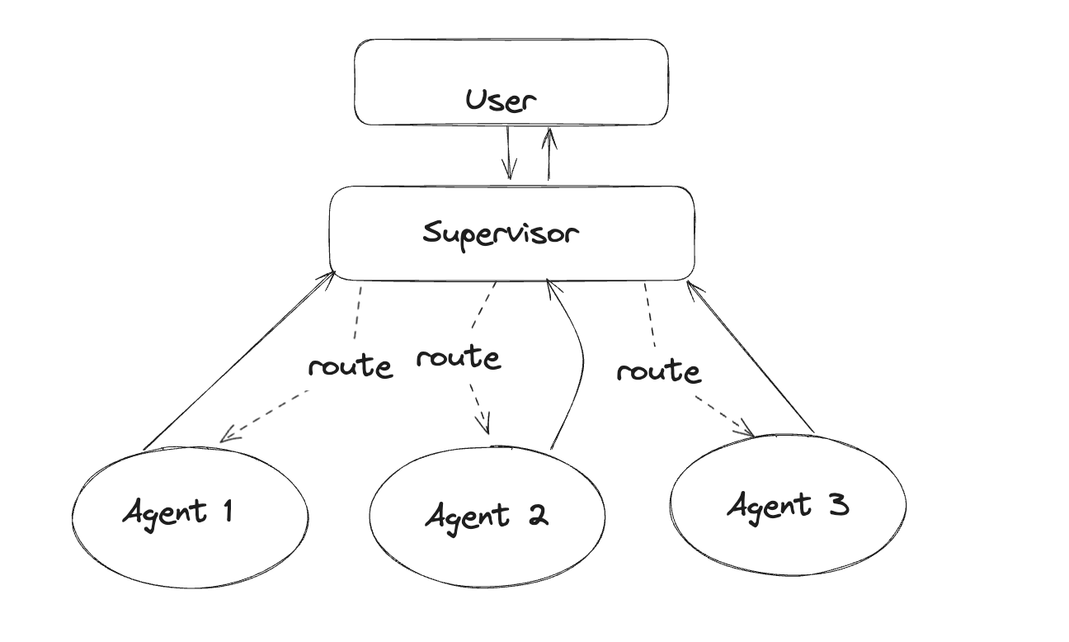
Let's Build our First AGENT Together

Slide 3

Why LangGraph
🎯 Efficient State Management
🤝 Simplified Multi Agent Coordination
⚙️ Flexibility and Customization
📈 Scalability for Enterprise Application

Slide 4
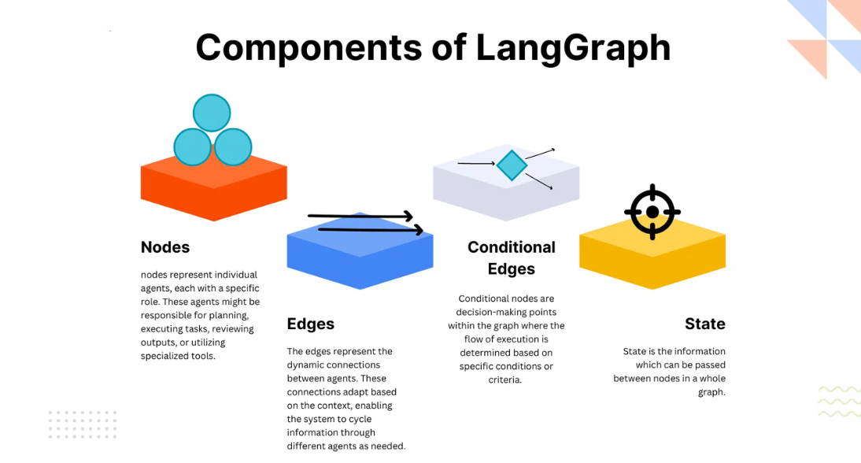
LangGraph: Components

Slide 5
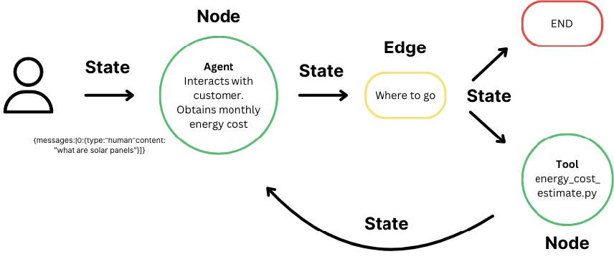
LangGraph: Foundational Building Blocks

Slide 6
LangGraph: Foundational Building Blocks
LangGraph is a low-level orchestration framework for building controllable agents. It enables agent orchestration — offering customizable architectures, long-term memory, and human-in-the-loop to reliably handle complex tasks.
LangGraph Buliding Blocks:
State
Central Concept: Represents all information flowing through the application.
User-defined: Fields should contain all necessary data for decision-making.
Nodes
Python Functions: Perform operations and update the state.
Types of Nodes:
LLM Calls: Generate text or make decisions.
Tool Calls: Interact with external systems.
Conditional Logic: Determine next steps.
Human Intervention: Get input from users.
Edges
Connections: Define possible paths through the graph.
Types of Edges:
Direct: Always go from node A to node B.
Conditional: Based on state or random decisions.

Slide 7

Why LangSmith
🛠️ Comprehensive Debugging and Testing
📊 Real-Time Monitoring and Observability
✅ Rigorous Evaluation for Quality Assurance
📈 Accelerated Development and Collaboration

Slide 8
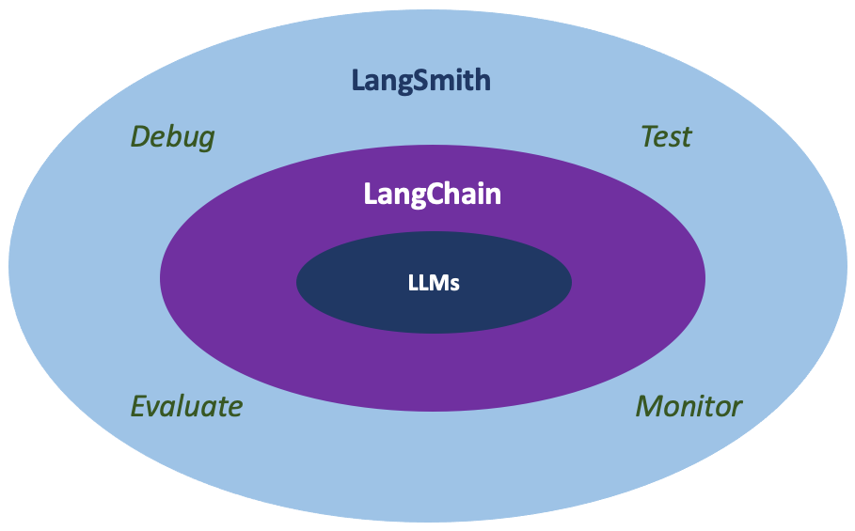
LangSmith: Introduction & Components
LangSmith is an all-in-one developer platform for every step of the LLM-powered application lifecycle. It supports debugging, collaboration, testing and monitoring of LLM applications.

Slide 9
Prompt Chaining: Link Prompts for Precision
Key Idea: Break tasks into sequential, feedback-driven prompts
Why? Boosts accuracy via step-by-step refinement (e.g., "Draft → Edit → Finalize" chains)
Use Cases: 1. Content Creation (Outlines -> Polished Drafts) 2. Troubleshooting LLM Outfit iteratively
Example: Writing a Blog.

Slide 10
Parallelization: Speed through Concurrency
Key Idea: Run multiple AI tasks simultaneously
Benefits: 1. 3–5x faster processing for bulk operations (data analysis, batch inferences) 2. Resource optimization (e.g., parallel API calls).
Applications: 1. Real-time customer sentiment analysis across channels. 2. Training multiple model variants at once.
Example: Writing different sections of a Blog concurrently.

Slide 11
Routing: Smart Tasks Allocation
Key Idea: Direct inputs to the best-suited AI agent/system.
Methods: 1. Context Based: Route to specialists (e.g., code vs. text models) 2. Load Based: Balance workloads dynamically.
Example: Get respective agent to write poem, joke or story basis on user's ask.

Slide 12
Orchestrator-Worker Models: Teamwork at Scale
Key Idea: Orchestrator delegates; workers execute.
Roles:
Orchestrator: Manages flow, monitors outputs.
Workers: Specialized agents (e.g., research, writing, validation).
Benefits:
Fault tolerance (replace failed workers).
Scalability (add workers for complex tasks)
Example:
Create a domain specific report, for e.g., healthcare.

Slide 13
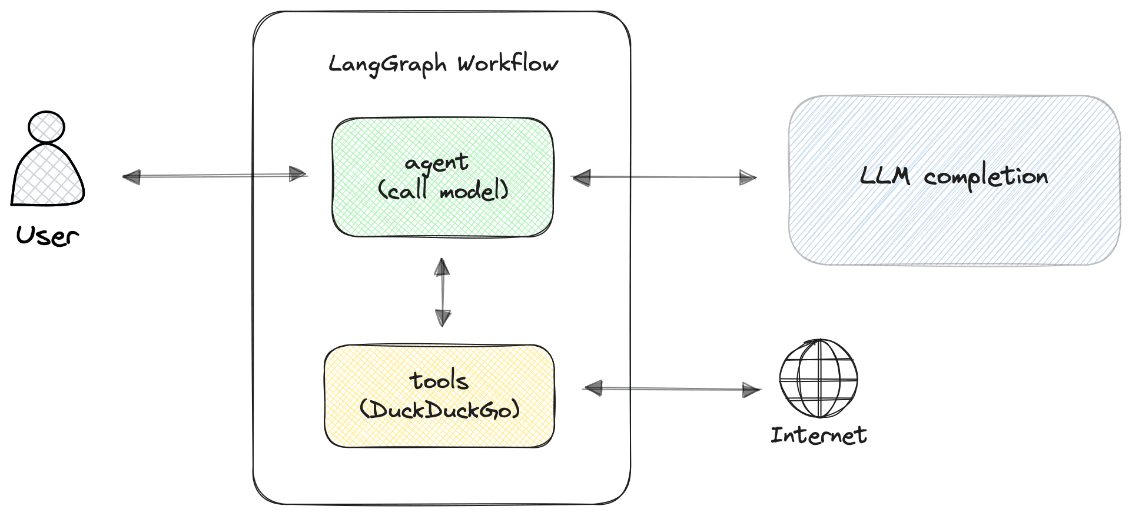
Enhancing the Agent with Tools

Slide 14
Thank You!
AI Agents: Automating the boring so you can debug the interesting!

